Slide 1
Ironhack Career Week Tech Challenge
VTC car fleet

Slide 2
Problem at hand
Analyse fuel consumption and find the most suitable fuel type
Link to the exercise: https://github.com/carlosruiz-stack/technical_challenge_DA/tree/master
Link to the Github repository: https://github.com/carlosruiz-stack/technical_challenge_DA.git

Slide 3
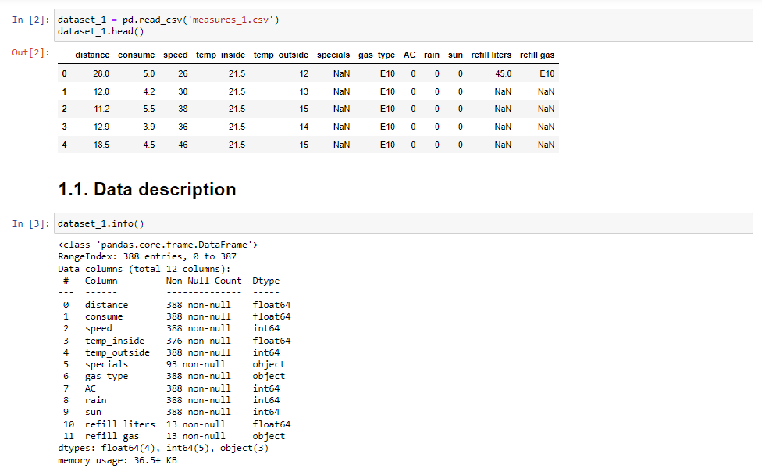

Slide 4

Starting point
A lot of NaNs, some data cleaning needed, for which we replaced NaN values in the num and cat dataset…

Slide 5

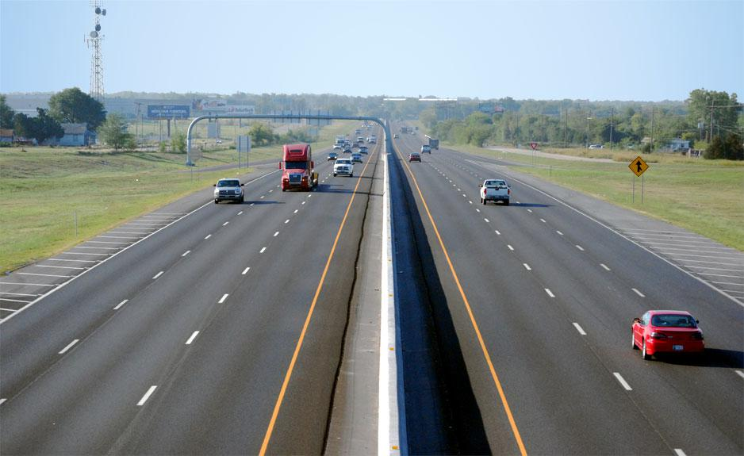
For the median in the num dataset

Slide 6


For the mode in the cat dataset
…yes, don’t look at me like that!!!!

Slide 7

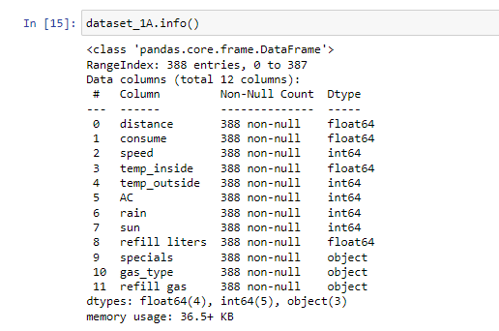
And then we came with a fresh dataset!!!!

Slide 8

Did some exploratory data analysis (EDA) and plotted some fancy charts which gave us interesting information…

Slide 9
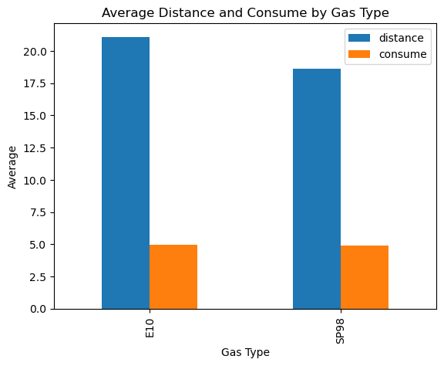
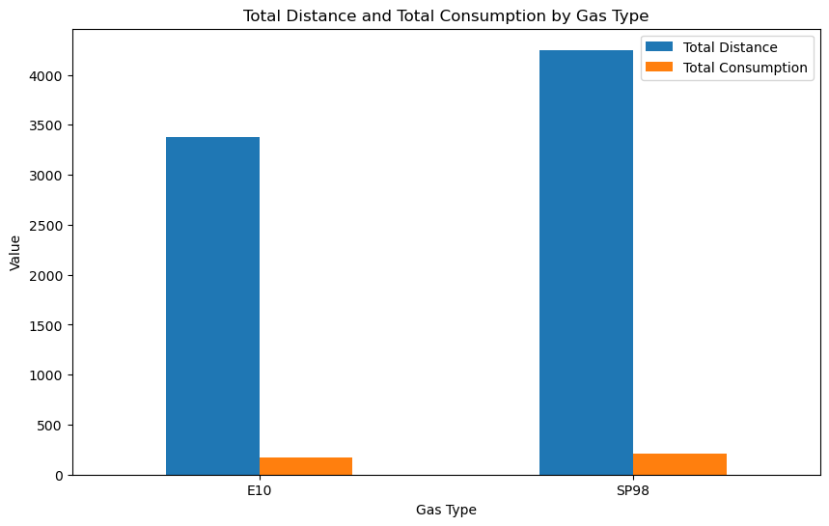
Distance and fuel consumption

Slide 10
Distance and fuel consumption
We found that on average, the distance of the ride is between 18 and 20 kilometers, which, in terms of aggregation, involves a total distance of 3.500 - 4.000 km for all the rides being analysed
Average consumption rate is 5 liters per 100 kilometers, which, translate into aggregate figures, gives us a total consumption of 175 - 200 litres
For this dataset we have no information on the fuel price, however we did some research from official (and thus reliable for the fact of being official…)

Slide 11
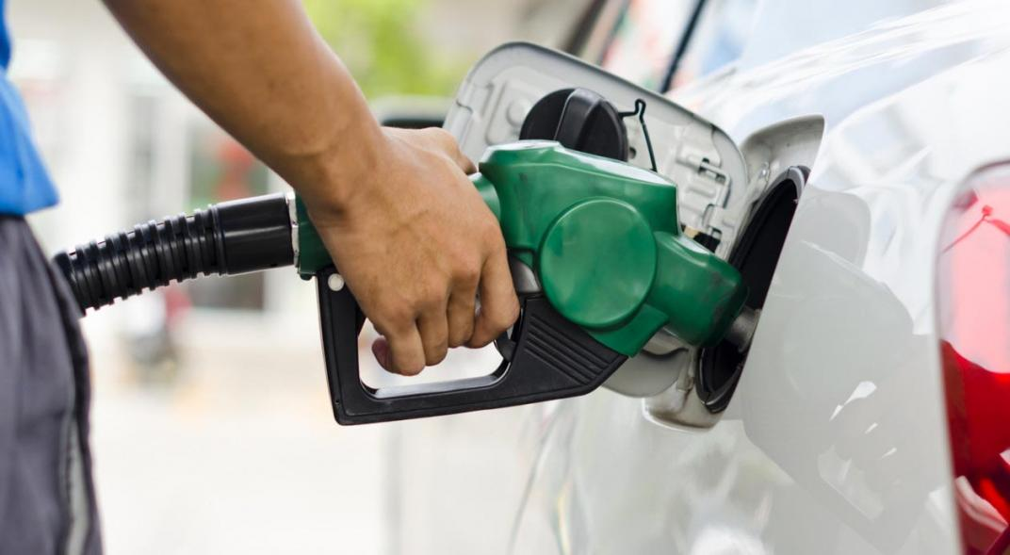
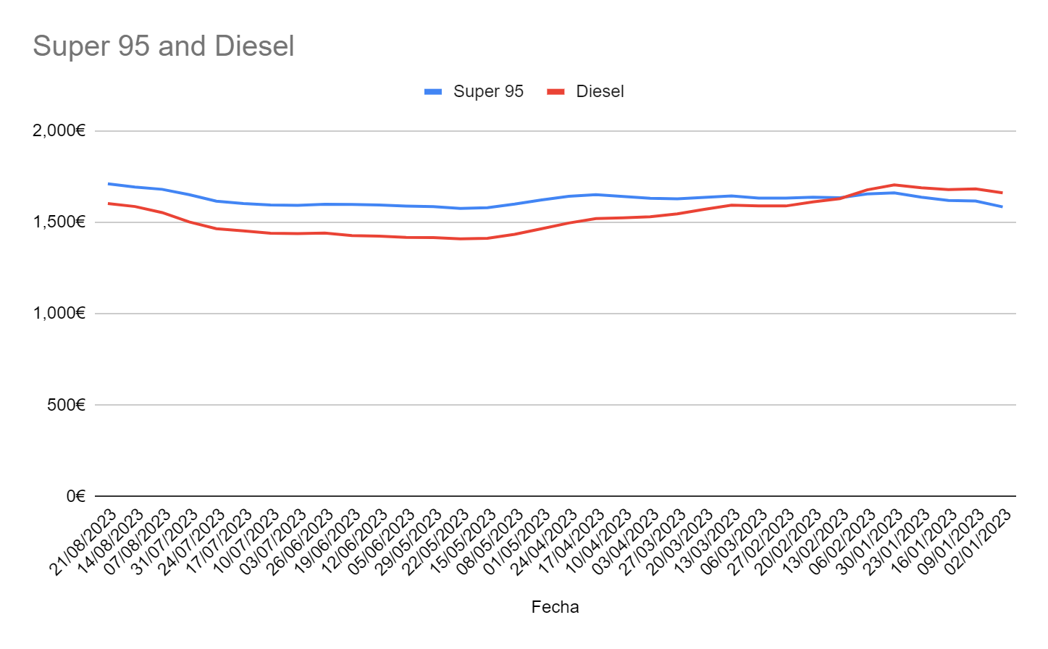
Fuel price evolution
 | Super 95 | Diesel
Avg. | 1.625€ | 1.535€
Max | 1.710€ | 1.704€
Min | 1.576€ | 1.409€

Slide 12


Fuel price calculation
Putting the numbers together, we can get an estimate of the total fuel consumption in monetary units, a key performance indicator for the business to be taken into account…of course we also want to think about the environmental aspect…

Slide 13
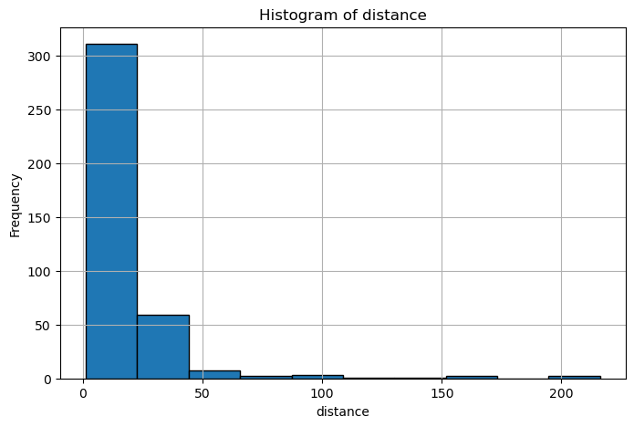
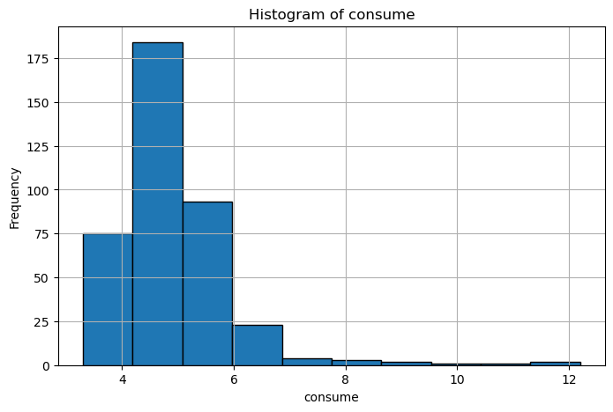
Histograms

Slide 14
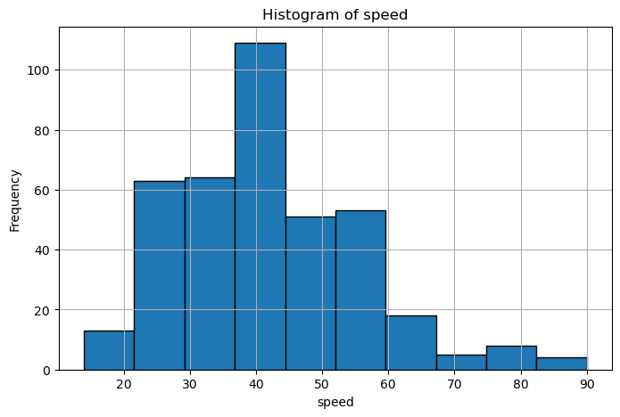
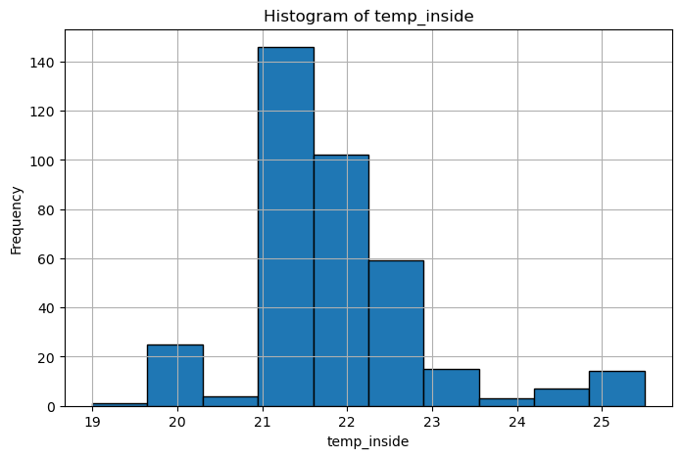
Histograms

Slide 15
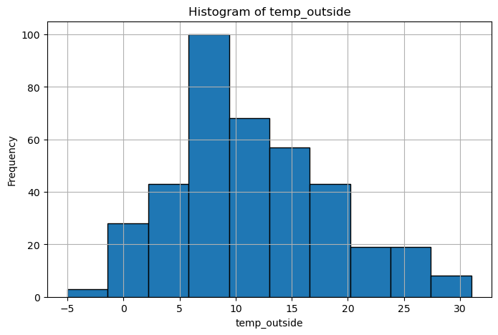
Histograms

Slide 16
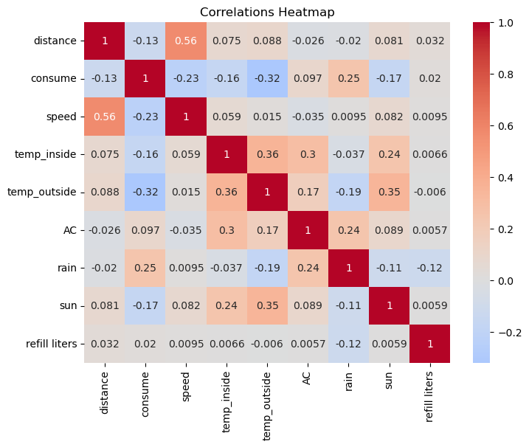
Correlations
We see some relationships between temperature-related variables (temperature inside-temperature outside, positive, 0.36); we may also conclude that conditions such as rain and sun also affect temperature (0.24 in the relation between air conditioning, AC, and rain, 0.17 and the relation between AC and temperature outside, 0.3 in the relation between AC and temperature inside); rain conditions also seem to affect consume (positive relation of 0.25). On the contrary, the amount of liters refuelled do not seem to be affected by any of the explanatory variables.

Slide 17
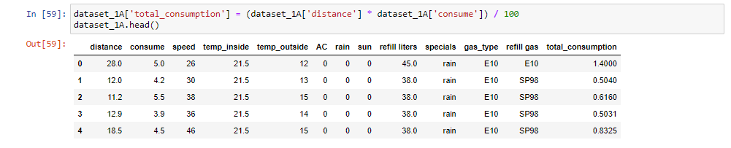
Some “transformations” in our model…
Consumption rate that we are given is the number of liters per 100 kilometers, in order to calculate the total fuel consumption, we will include a new column in the table, "total consumption", which is the result of multiplying the consumption rate times the number of kilometers, divided by 100. We will have a new variable in our dataset, this will be the target:
Notes:
On this version of the jynb file we removed the column ‘specials’; we observe that 'specials', which refers to the driving conditions, has some repeated values, such as "AC sun" and "AC Sun" , "ac" and "AC", "AC sun" and "Sun ac". Since we already have the columns AC, sun and rain coded, we decided to remove this column, the information was displayed with ununderstandable criteria and did not find that reliable. Though we kept this column in the original version for the ML model, in order to compare results.

Slide 18
Machine learning
categorical_columns = dataset_1A.select_dtypes(include=['object']).columns
dataset_1A = pd.get_dummies(dataset_1A, columns=categorical_columns, drop_first=True)
X = dataset_1A.drop(columns=['total_consumption'])
y = dataset_1A['total_consumption']
X_train, X_test, y_train, y_test = train_test_split(X, y, test_size=0.2, random_state=42)
model = LinearRegression()
model.fit(X_train, y_train)
y_pred = model.predict(X_test)
Mean Squared Error: 0.012895220610231878
Root Mean Squared Error: 0.11355712487656544
Mean Absolute Error: 0.058221577789319884
R-squared: 0.9924541713964911

Slide 19
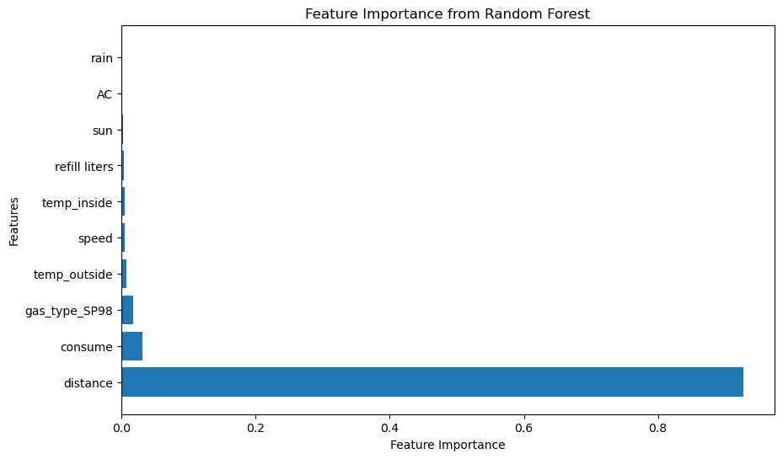
Machine learning
Notes:
In terms of feature importance, distance seemed to be the variable that affected most our target, total consumption, which is logical on the other hand, as total consumption depends on the distance, among other variables.

Slide 20

Analysis of variance (ANOVA)
We want to find if the average speed has been different in cars that used as a gas_type SP98 and E10, assuming a confidence level of 99%. For this, we will perform the analysis of variance (ANOVA), where we will compare the p-value to the significance level in order to decide whether we keep the null hypothesis of we reject it.
ANOVA Results:
Statistic: 3.6939
P-value: 0.0553
Significance Level (alpha): 0.0100
Since the p-value is higher than Alpha, we maintain the null hypothesis that the average speed does not vary from cars with one fuel type to another (SP98 vs. E10).

Slide 21

Speed comparison
It is a good idea to analyse avg. speed as it is something that also affects fuel consumption, a deeper analysis of the driving style, you don’t have the same fuel consumption in a normal than an aggressive style, so this would also give us interesting insights…

Slide 22
To conclude…
We have performed an analysis on the dataset provided, created a machine learning model to predict fuel consumption based on the variables provided, with some transformations, and also suggested the creation of a streamlit user interface with a python script to calculate fuel consumption.
Apart from the above, we have also gathered some external information regarding fuel prices to get an estimate of the fuel consumption which is a kpi for this taxi company.
A value-adding solution would also be having an application for fleet management where you can keep track, not only of the fuel consumption, but also of the driving style, speed, and keeping control of upcoming preventive maintenances, this can easily be achieved with different applications existing in the market.

Slide 23

One more thing, I’ll keep short!!
Vodafone Business Fleet is the latest in IoT vehicle management system for medium and large enterprises, that uses the Geotab device connected to the OBD in the vehicle that provides top management with invaluable information on the overall vehicle fleet performance for an efficient management.
If you want to find out more on this solution, you can directly contact me on my business email, carlosruiz@servitelxxi.es, and I will be happy to assist you with the choice of the best solution for your business
https://www.youtube.com/watch?v=7URkcLcLVqM&pp=ygUXdm9kYWZvbmUgYnVzaW5lc3MgZmxlZXQ%3D

Slide 24

I appreciate your time, thank you for your attention

